Slide 1
CAREER ANALYSIS
IN DIFFERENT WORKFIELDS
Group Members:
ANKITA SINHA
(15BCS2240)
SHIKHA MAHAJAN
(15BCS2221)
ACHAL AWASTHI
(15BCS2142)

Slide 2
What is CAREER ANALYSIS?
The amount of data being produced in modern society is growing at an accelerating pace. New problems and possibilities constantly arise from this so-called data explosion. One of the areas where information plays an important role is that of law enforcement. Obviously, the amount of criminal data gives rise to many problems in areas like data storage, data warehousing, data analysis and privacy. Already, numerous technological efforts are underway to gain insights into this information and to extract knowledge from it.

Slide 3
What Is The OBJECTIVE Of This Project?
The main objective of this project is to focus on the career predication of a person based on some simple questions which are asked to him.
Now we apply different types of data analysis on our database and try to predict which career field is best for that person.
People use this project to understand which career field is good for them and they can apply on those fields and go ahead .
This project will increase the capabilities of peoples as they already know in which working field they are good and then can take that field as there career building.
This project also decrease the pressure and stress on people as there are now work in the environment in which they like and performs task in which they are good.

Slide 4
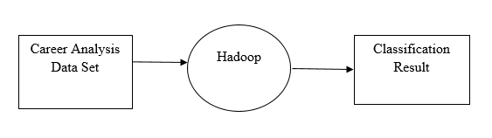
Working PROCESS
LEVEL 0 DFD

Slide 5
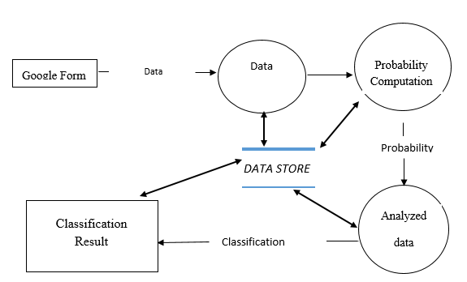
LEVEL 1 DFD

Slide 6
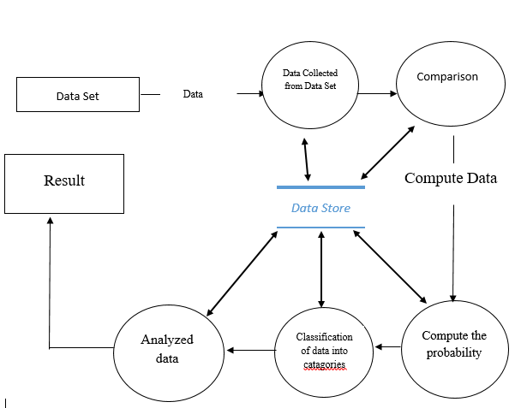
LEVEL 2 DFD

Slide 7
HARDWARE/SOFTWARE REQUIREMENTS:-
HARDWARE SPECIFICATIONS:
PROCESSOR: Intel Core i3
RAM: 4 GB
HARD DISK: 500 GB
MONITOR: LCD Monitor
KEYBOARD: 101 keys or more
MOUSE: Simple Mouse
NETWORK: Internet
SOFTWARE SPECIFICATIONS:
PLATFORM: Windows 10
SOFTWARE: VMWARE Work Station, IBM Infosphere, Hadoop (HDFS and Map Reduce) ,Pig

Slide 8
FUTURE SCOPE OF THE PROJECT
Career Analysis attests the effectiveness of career counseling. Our career analysis project can support people with career-related challenges.
Finally, Our project are often capable of supporting peoples in finding suitable placements/ jobs, in working out conflicts with their employers, or finding the support of other helpful services.
It is due to these various benefits of career counseling to without wasting money in huge amount.

Slide 9
OUTPUT

Slide 10
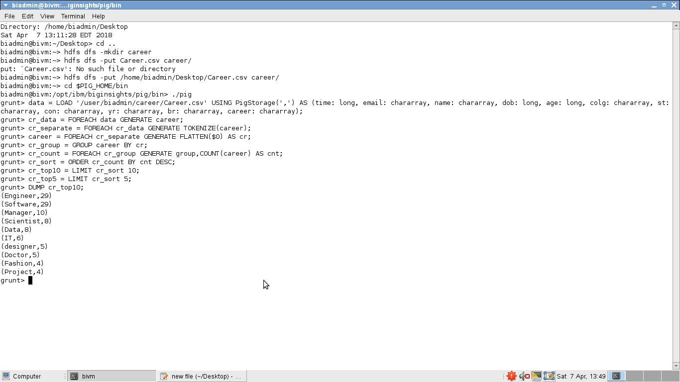
Top 10 CAREER choice in this data set

Slide 11
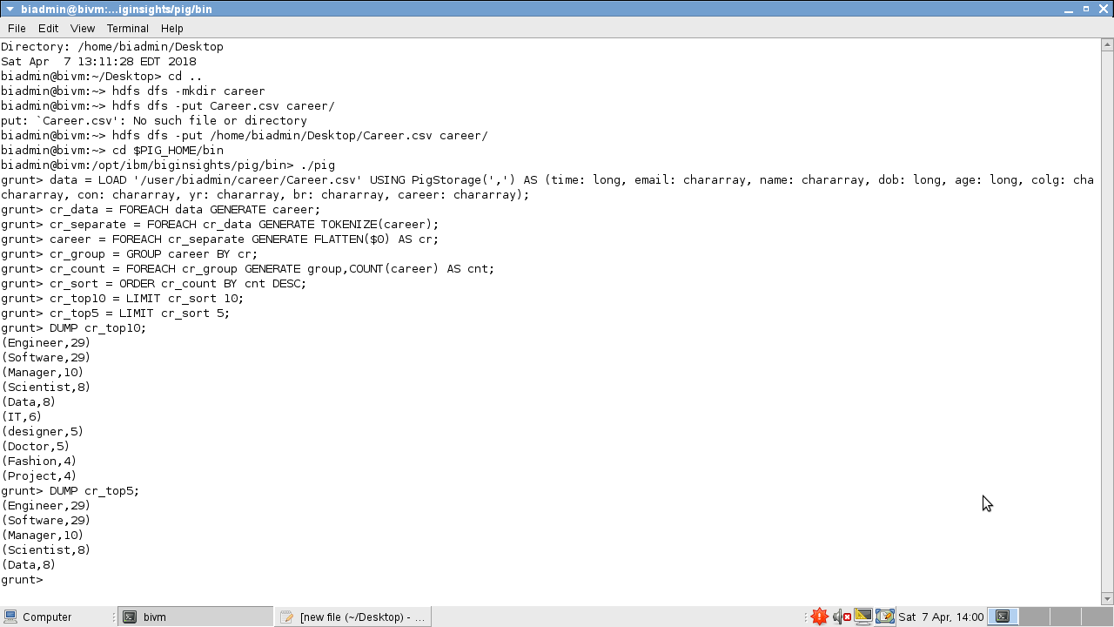
TOP 5 CAREER choice in the data set

Slide 12
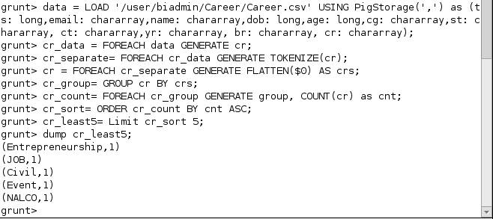
LEAST 10 CAREER choice in the data set

Slide 13
THANK YOU

